Slide 1
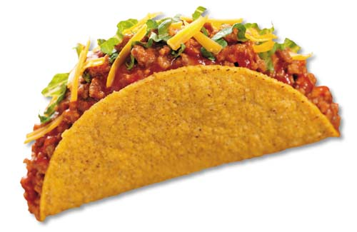
@
All-U-Can Eat $4
Pinnacle YL 7:00 @ Bell/Tatum Taco Bell
Monday Nov 8

